Slide 1
Edgar and Ivy’s
Community Cat Class
Let’s Raise an army of trappers!

Slide 2
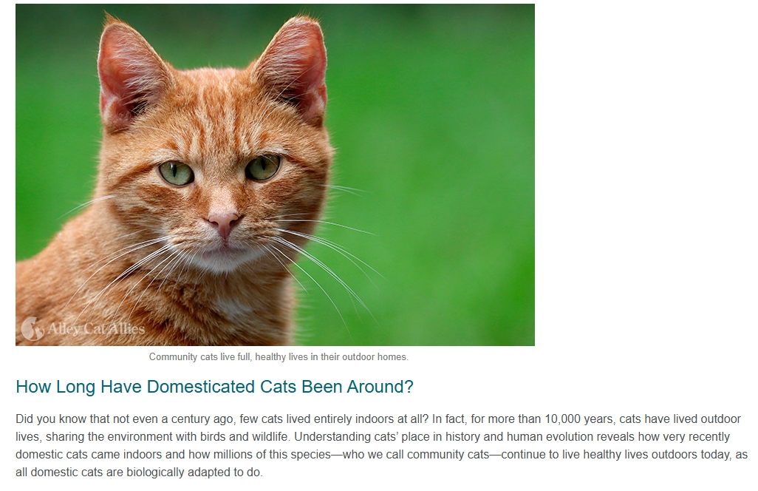
History of the Cat
100 years ago, cats did not live indoors
Cats have been living outdoors for 10,000 years
Cats began their unique relationship with humans 10,000 to 12,000 years ago
Cats formed a mutually beneficial relationship with people, and some scientists argue that cats domesticated themselves. Especially prized as mousers on ships, cats traveled with people around the globe
Unlike dogs, biologically cats are the same as they were thousands of years ago.

Slide 3
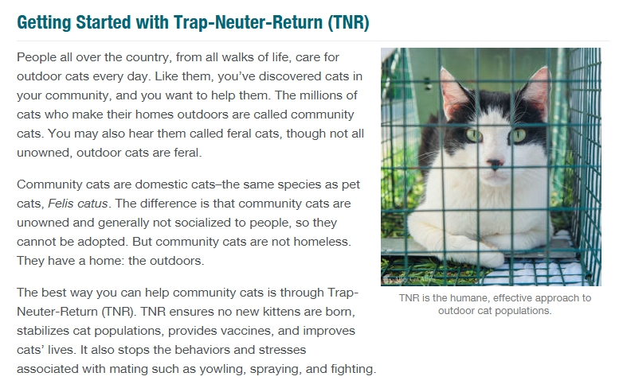
What is a community cat?
Born Outside
Dumped/Abandoned
Lost Cat
Indoor/outdoor pet

Slide 4
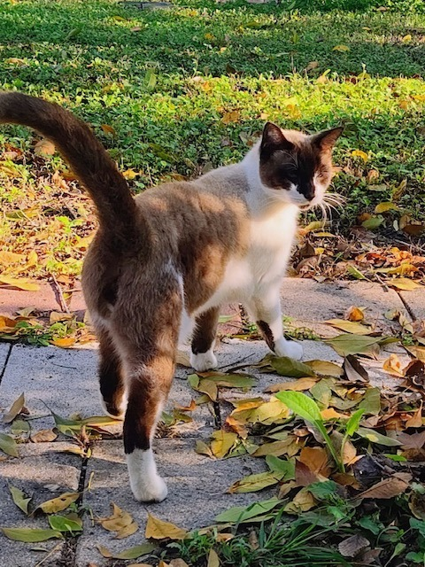
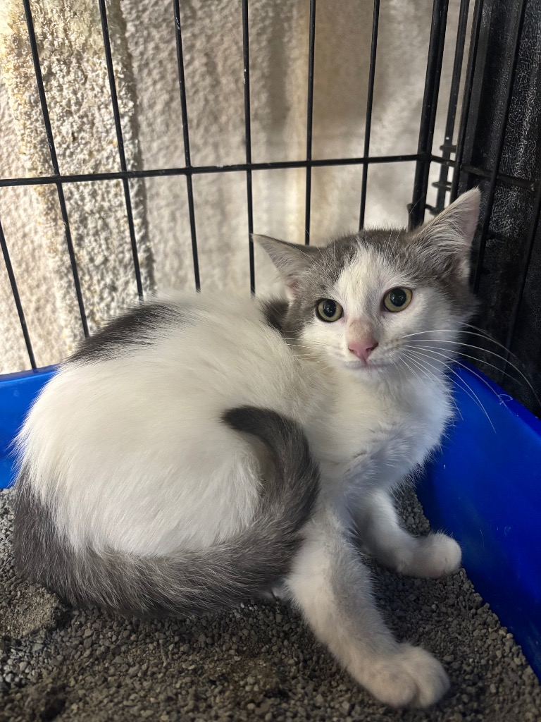
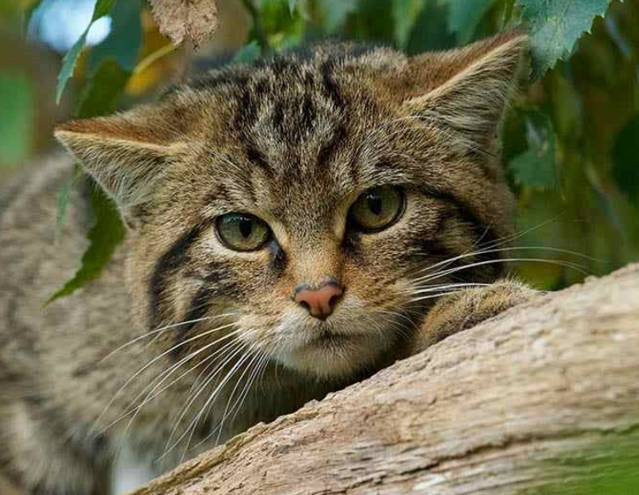
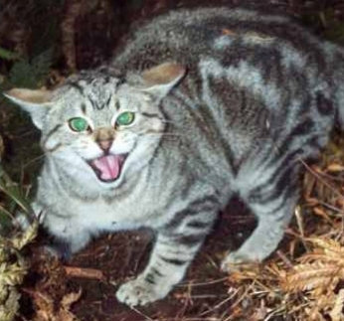
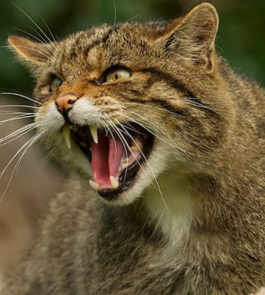
FAS Score Friendly to Feral
FAS 0-1
FAS 2
FAS 3
FAS 4
FAS 5

Slide 5
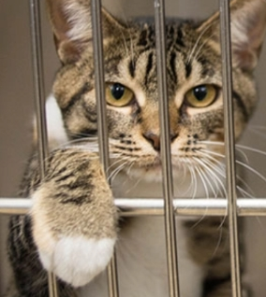
Why TNR
Virtually every community cat who enters a shelter is killed there. Shelters are the number one documented cause of death for cats, nationwide.
Trap-Neuter-Return relieves cats of the constant stresses of mating and pregnancy
Mating behaviors cease, like roaming, yowling, spraying, and fighting.
Cats’ physical health improves
Cats are vaccinated against rabies
TnR meets the needs of the community-No new kittens, relationship with residents improves. Colonies become quieter

Slide 6
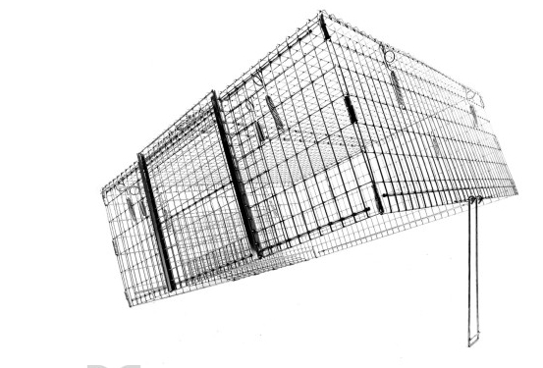
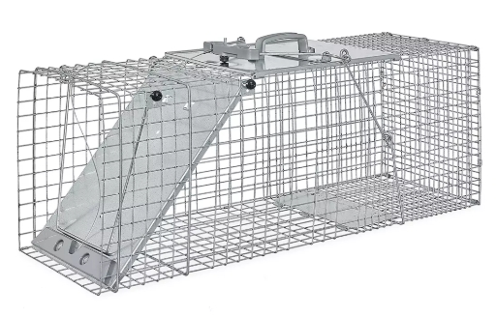
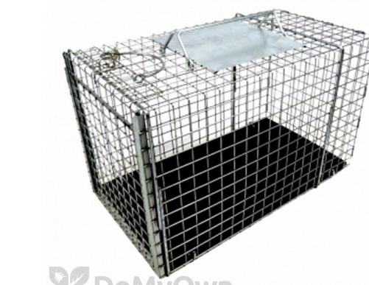
The Tools
Drop Trap
Walk In Trap
Transfer Trap

Slide 7
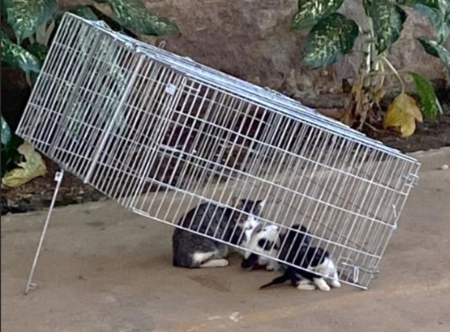
Drop trap versus walk in trap
The Drop trap can be used to condition
The Drop can catch multiple cats
The Drop can catch a single cat out of a colony
The walk-in trap can be out of view for the shy cats
The walk-in is easy, and no transfer is required
The walk-in doesn’t work for small kittens
The walk-in is lighter and fits in smaller vehicles

Slide 8
The Supplies
  Work gloves
  Spoon or fork
  Tape
  Reusable baggies
  Small food storage containers
  Paper towels
  Antibacterial wipes, gel, or spray
  First Aid Kit
  Bungee cords
  Zip ties or carabiners
  Pen or pencil notebook, sharpie
  Flashlight
  Tap Light
  Cleaning and disinfecting supplies
Isolator -also called trap divider or fork
Drop/walk in/ transfers
Cord with D clip
Trap cover
Trap label
Bait
Pee Pads

Slide 9
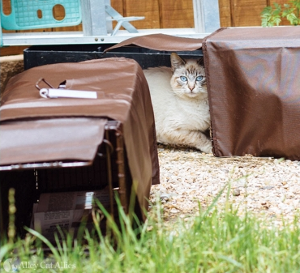
Prepare to trap
Walk through the area Right before sunset
Stop and talk to people
Watch for the cats/Observation
Find the feeders
Stop the feeding 24 hours before
Gather phone numbers
Explain you are there to help

Slide 10

Encounters with the public
Wear your badge
Explain you are not hurting the cats
You are getting them “fixed and vaccinated” and bringing them right back
De-Escalate always- Be friendly and accommodating
Stay out of danger
Leave if you need to
Never go inside

Slide 11
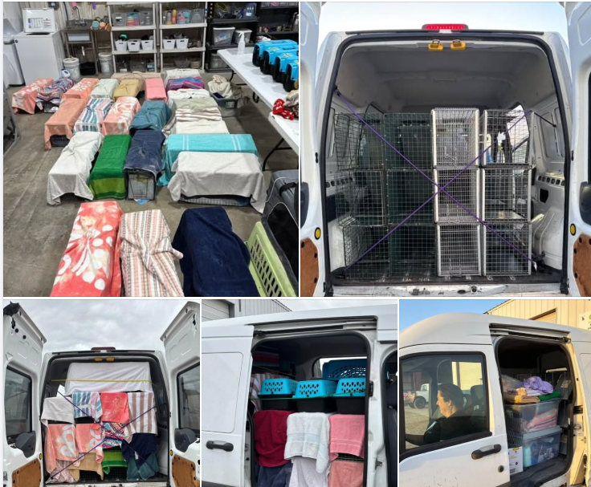
Things to consider during the trapping
The public
The feeding spot
Concrete versus grass
Sunset/night
Taking a buddy
Lighting

Slide 12
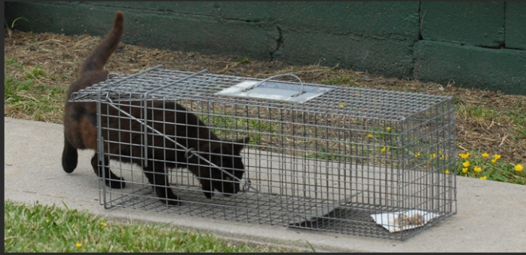
Bait and wait
Pick the right bait
Be quiet and don’t leave a footprint
Trap where they are fed
Use the feeder
Stay out of site
No perfume, loud talking, and don’t stare at the cat
Have patience

Slide 13
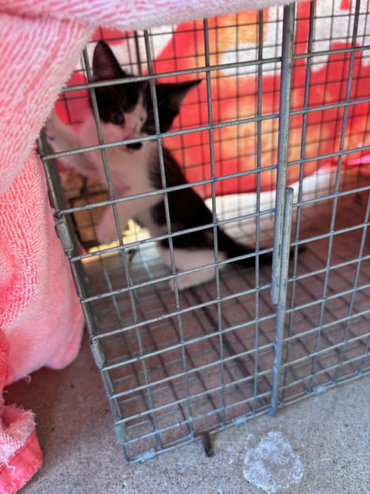
Protect the cat
Never leave a trap unsupervised
Cover the trap immediately after it is tripped
Cover the transfers
Keep stress level down
Lock the trap
Be calm and quiet

Slide 14
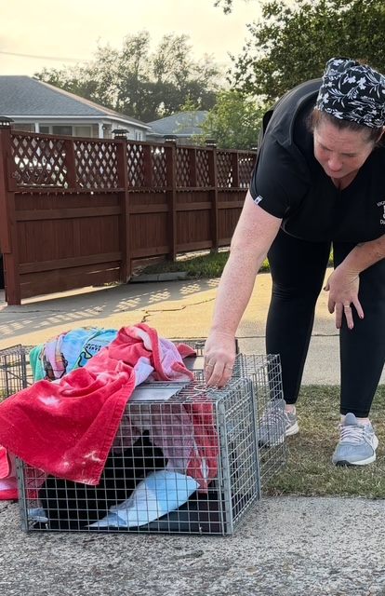
Your safety
Watch those fingers
Never grab the cat
Don’t scruff
If you are bitten call animal control and go to the ER. Rabies is no joke
Don’t be near traffic in the dark
Be aware of your surrounding
Leave if you need to
Work as a team

Slide 15
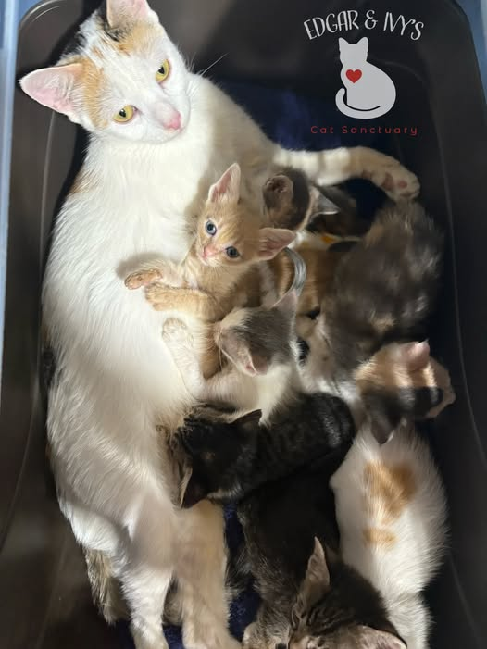
Pregnant cats
Spay/abort
Letting the cat Have the babies
Females can get pregnant at 4 months
Last weeks and spay surgery
Kitten death rates
Pyrometria

Slide 16
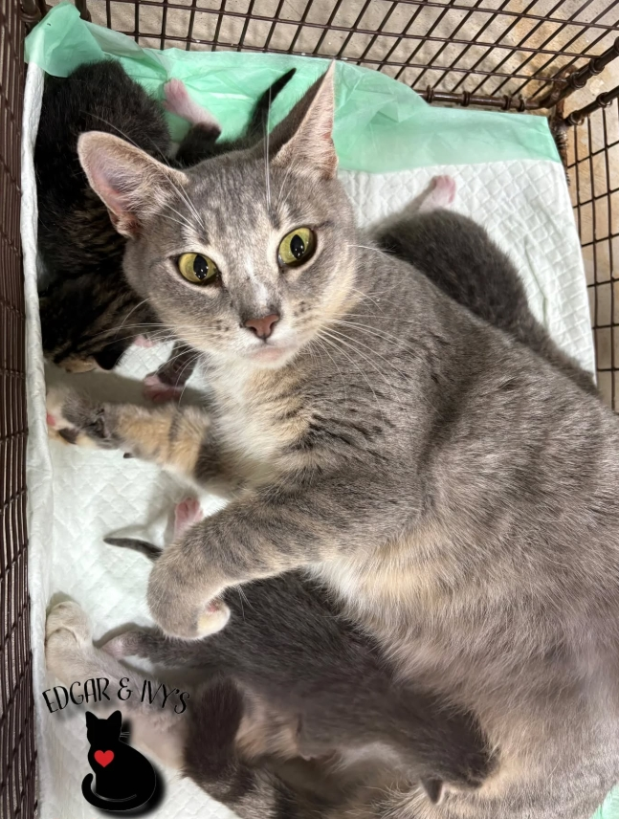
Nursing moms
So, she's got milk!
Talk to the residents
Find the babies
Release the cat
Do a flank spay
Schedule a return to trap

Slide 17
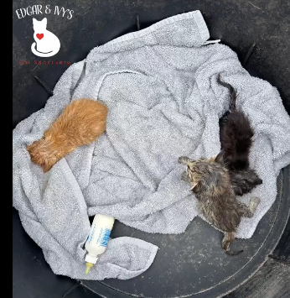
kittens
0-4 weeks Leave them Be!
4-6 weeks Not without mommy!
6-8 weeks time to trap and turn them
8-10 trap and return on a case-by-case basis
Over 10 weeks TNR if FAS above 2
Over 12 weeks TNR in most cases

Slide 18
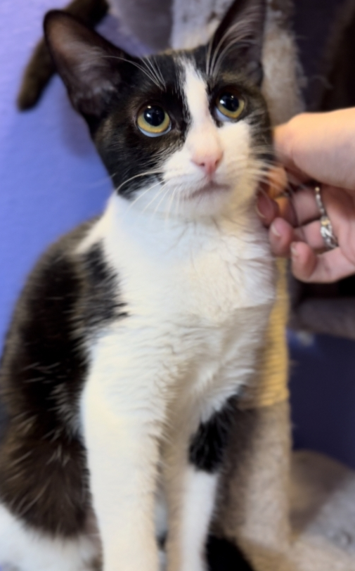
Friendly cats FAS 0
Trap-Neuter-Return, not Trap-Neuter-Adopt
could even lead to the death of a cat who was happy and healthy outdoors
Community cats aren’t homeless their home is outdoors
resources that could have been spent carrying out Trap-Neuter-Return (TNR) for hundreds of cats
committed caregivers
Community and cat families

Slide 19
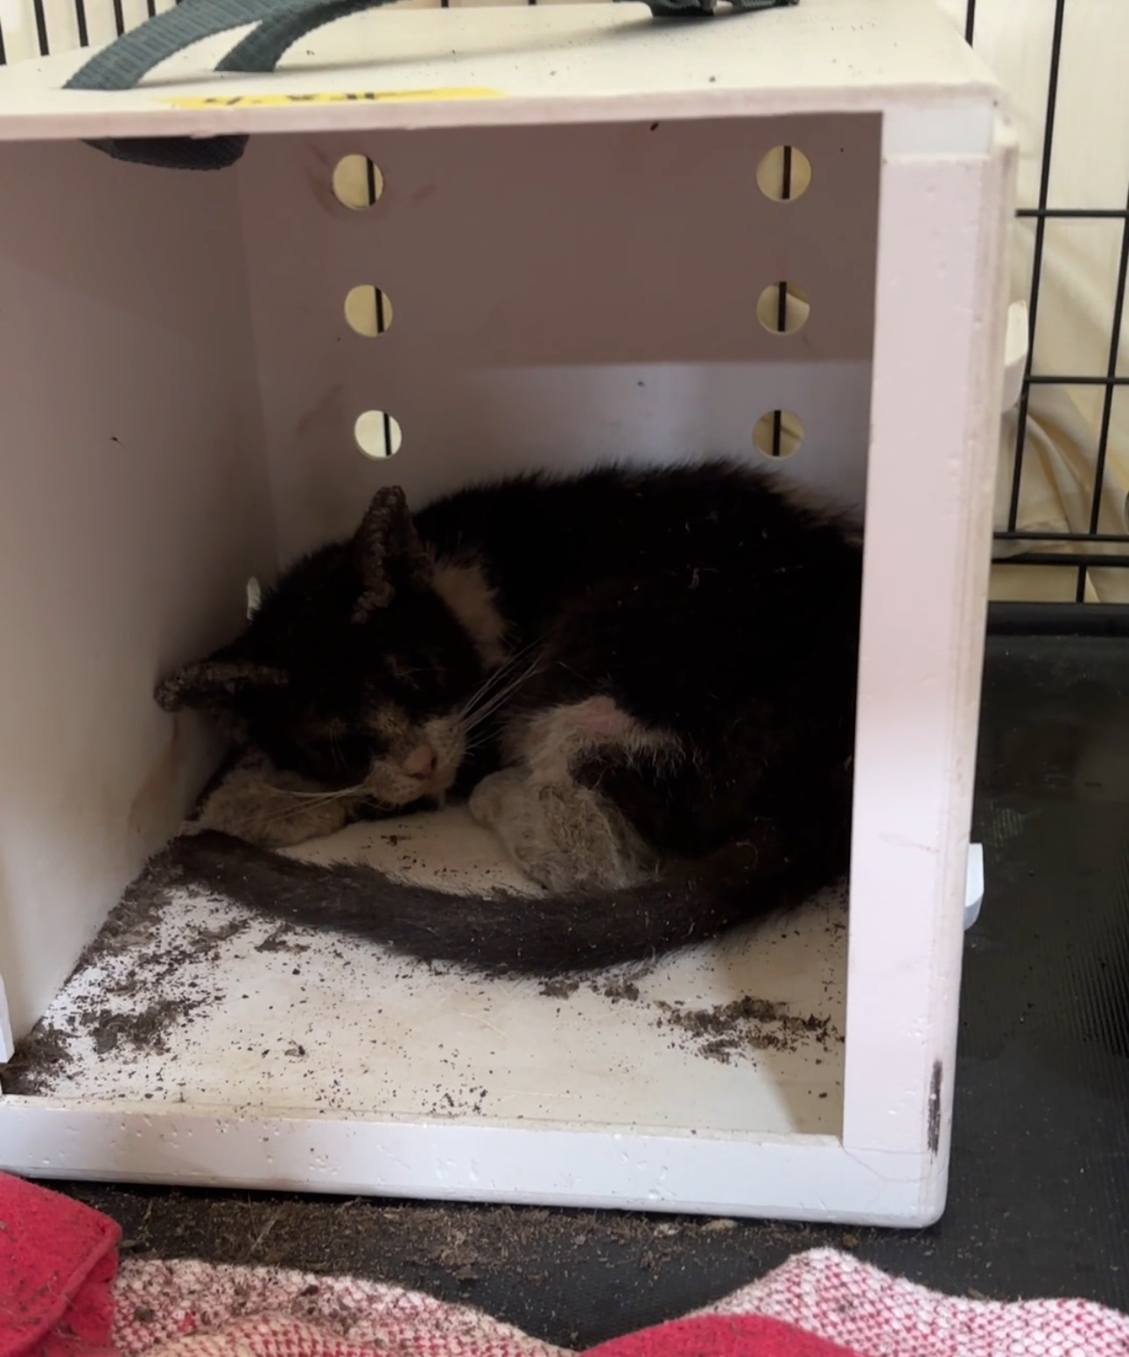
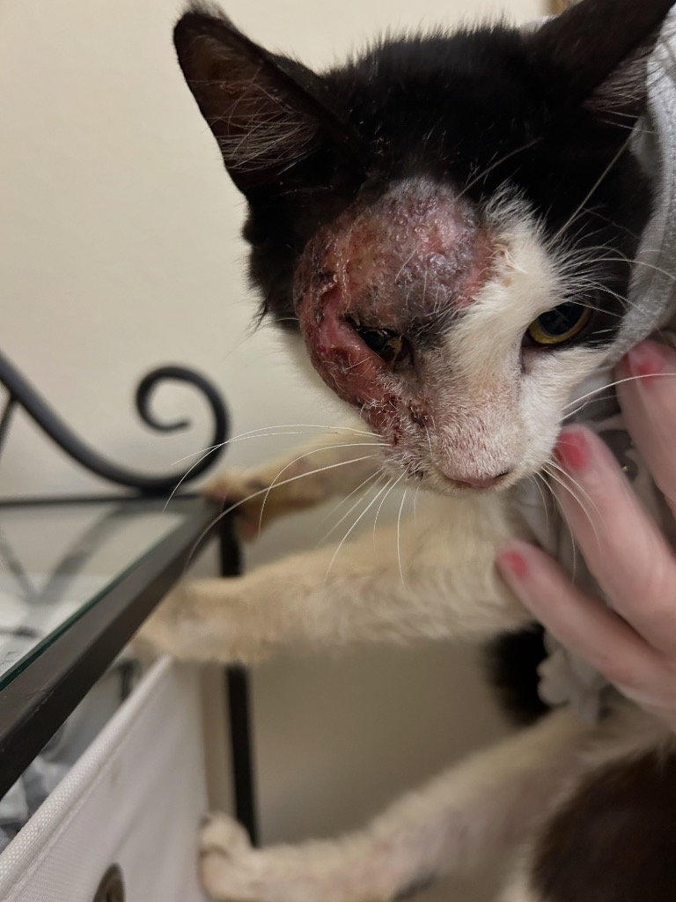
Trapping the sick or injured
Don’t Trap without a plan of action
Don’t bring indoors
Don’t use human medications
Seek local help by taking pictures
Let the shelter know if you can provide financial help for vet care
The Red flags-open mouth breathing, severe hair loss, constant diarrhea, immobile, dragging, eye rupture, tumor.

Slide 20
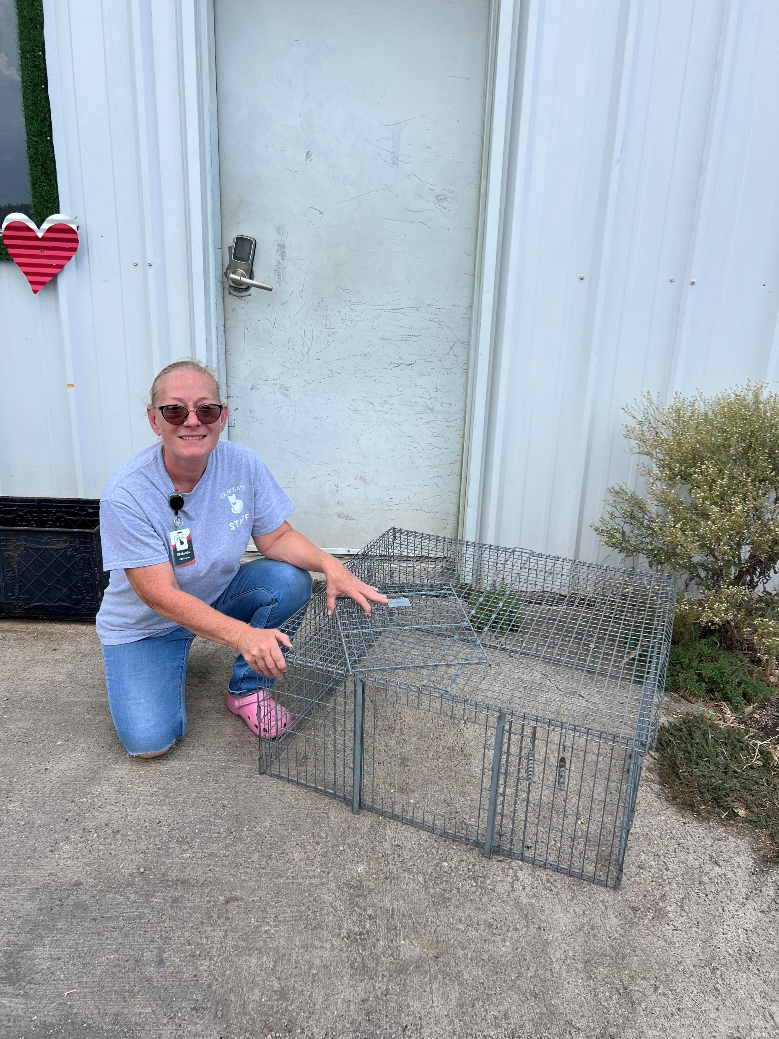
Hard to trap cats
Conditioning with a drop trap
Zip tie walk in and Move food closer to back of the trap daily
Use a larger trap
Cover the trap
Withold food
Smelly food
Food trail
Side by side traps
Go High

Slide 21
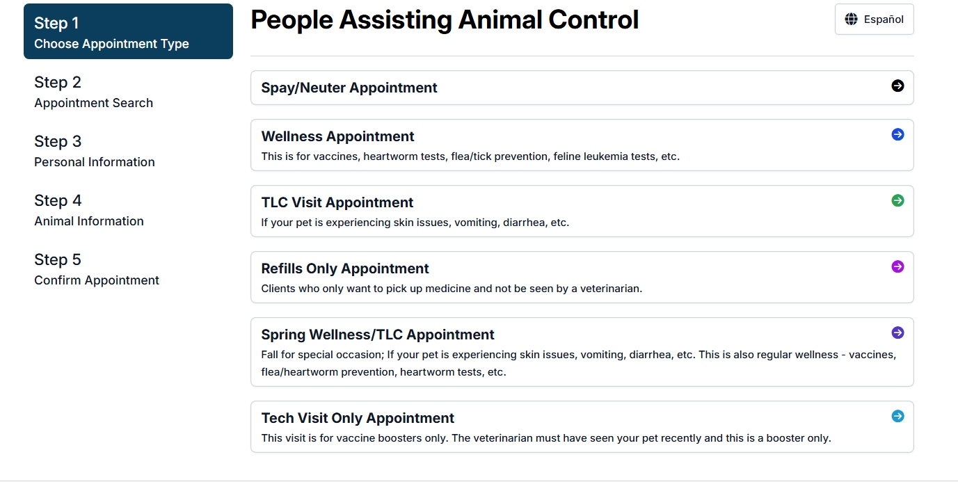
The spay/neuter appointment
Schedule the appointment before you trap
Label the trap with color of cat, name, gender, street address it came from
No food or water after midnight
Arrive on time or early
Ask about Pick up time
The community cat package/ear tip
Don’t give up on appointment availability

Slide 22
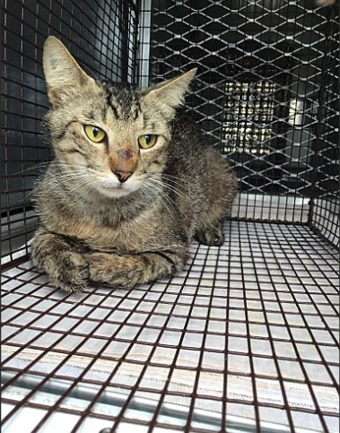
Overnight care
Put the trap on a pee pad
Use fork to put in food and water
Cover the cat
Transfer the cat
Watch for bleeding and signs of pain
Keep it dark and quiet and animal free

Slide 23
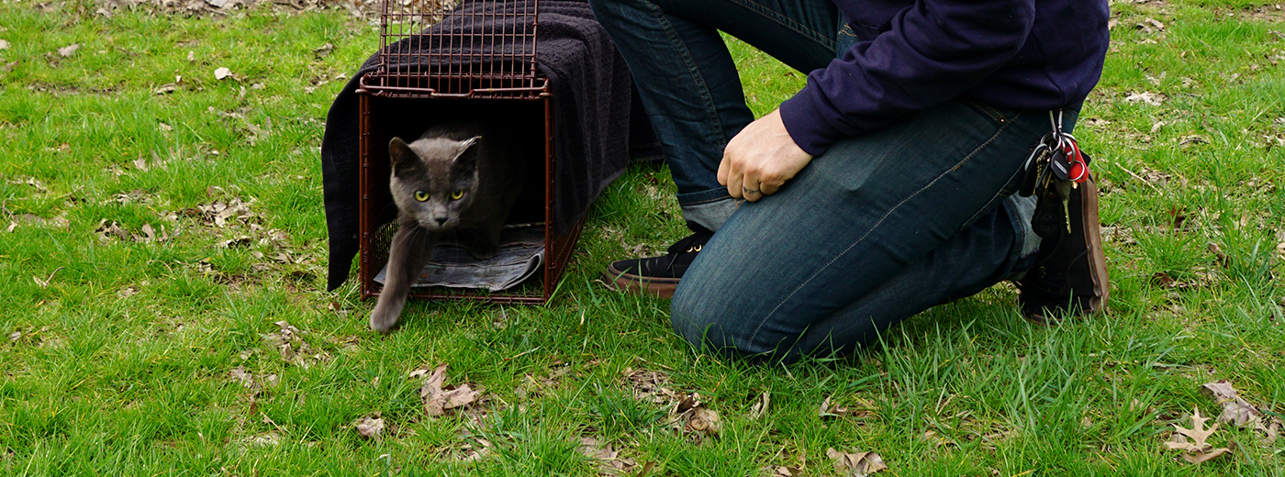
The Return
Go at night or dusk if possible
Return to the exact location
Watch your surroundings
Don’t be misidentified as a dumper-wear your badge or shirt
Give the cat time
Choose the best Location
Tell the caregiver if applicable

Slide 24
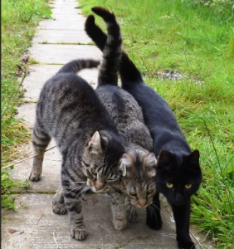
Cat colonies-Families and relationships
Cats form strong bonds
females form the core of cat society. Each female's extended family includes children and grandchildren, all of whom have grown up in close relationship with each other.
Adults teach kittens and juveniles appropriate social skills and hunting techniques
intact males who pair up with other males and the two interact in a way which indicates friendship such as touching noses, mutual grooming, playing and resting together.
Cats bond with their caretaker.

Slide 25
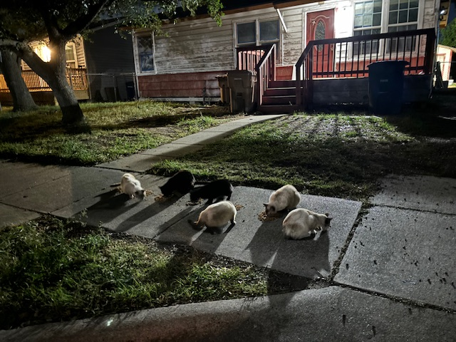
Community caretakes
Difference between an owner and a caretaker
30 percent of people are caretakers
Caretakers know their cats
Caretakers should not be punished by ordinances
Difference between a caretaker and a hoarder
Find a shelter to partner with

Slide 26
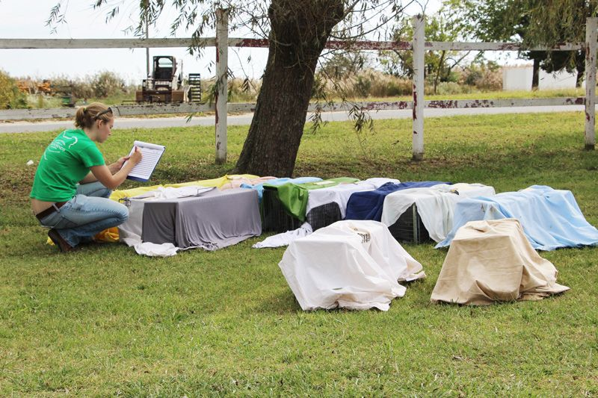
Targeted trapping
aiming to trap every cat in a colony
expanding to surrounding colonies
Identify “Hot Spots” Where Cats Live
Document Your Progress and Success
Communicate with the Colony Caretaker
Leave no female unsterilized-return to trap when needed.

Slide 27
relocation
99 percent of the time relocation is never the answer
Considered Dumping by law
if relocated, may try to find their way back. In some cases, cats have died in the process
Vacuum Effect
Construction or demolition is taking place where cats live
You are a community cat caregiver, and you are moving out of the area
seven steps must be followed in order to ensure a successful and safe relocation

Slide 28
The Legal Stuff
Trap on public property
Get permission to trap on private property
Don’t trespass
Use approved equipment-Humane traps
Don’t keep a tipped cat
Don’t take a cat with a tag
Return to exact location
Interaction with police or animal control
Texas has recently enacted House Bill 3660, which provides legal protections for Trap-Neuter-Return (TNR) programs, allowing individuals to manage feral cat populations without the risk of being prosecuted for animal abandonment.

Slide 29

Financial help
People Assisting Animal Control
Alley Cats Allies
Food Bank
Expired food
Social Media
Get that 501 designation

Slide 30


Cleaning your equipment
Dawn dish soap power wash
Bleach and water
Dry in sun
Olive oil and qtips
Wash fabrics in bleach

Slide 31




Alley Cat Allies
Humane World for animals
P.A.A.C
Best Friends
alleycat.org
Humaneworld.org
Ccpaac.org
Bestfriends.org

